Slide 1

Final Year Project Biometric Data Analysis in Digital Game Scenario
Otito Mbelu
Rodrigo Almeida
BSc. Computing in Software Development
Applied Project & Minor Dissertation
Supervisor: Dr. Damien Costello

Slide 2


Context & Objectives
AIM
TEST GAME
Find a correlation between a user’s current physical condition as indicated by their Biometric data, and their performance in a digital gaming scenario.
1
Test Application
Test Results
Context
BIO DATA
TEST
BIO DATA
ANALYSIS
VOLUNTEER RECRUIT
INFRASTRUCTURE
2
Device Monitor
Biometric Results
INFRASTRUCTURE
5
ANALYSIS
3
Regression
Classification
Correlation
RECRUITMENT
4
Ethics Approval
Volunteers

Slide 3
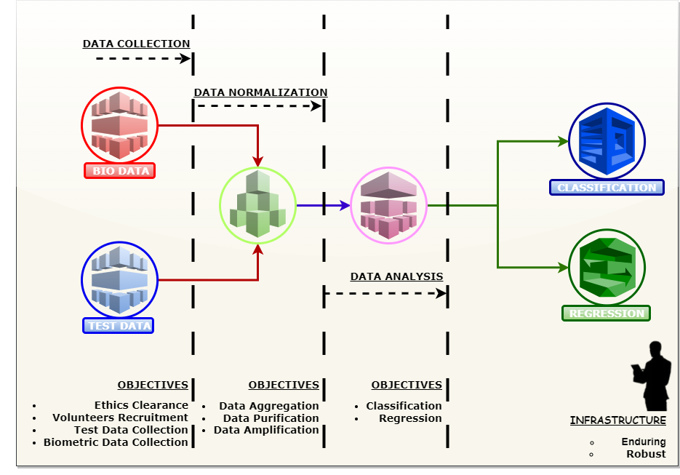
Project Summary

Slide 4
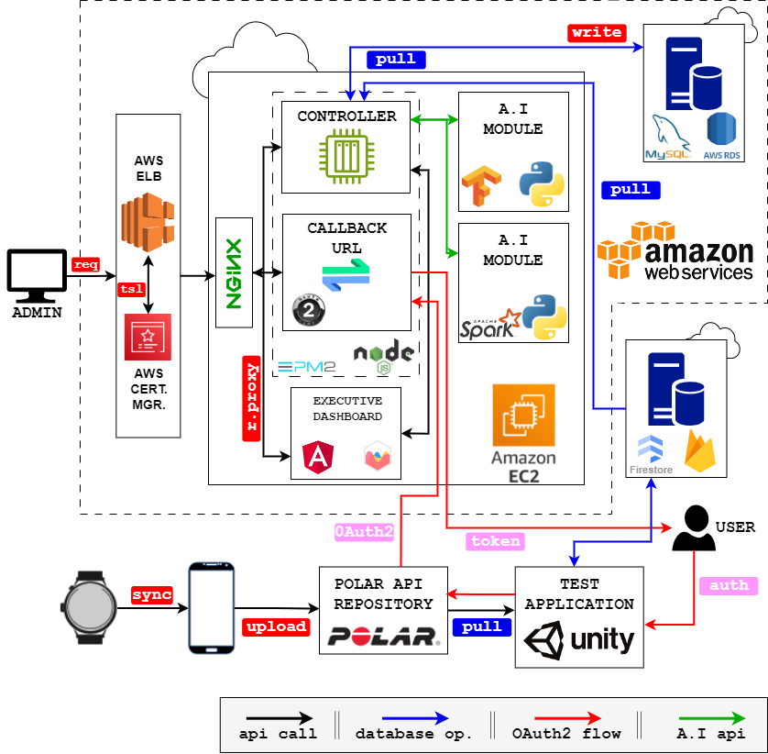













ARCHITECTURE
SYSTEM ARCHITECTURE & TECHNOLOGIES
TECHNOLOGIES
Node JS
Express JS
Angular JS
Apache
Docker
TensorFlow
Chart.js
AWS Services
PM2
Firestore
NGINX
MySQL
Firebase

Slide 5


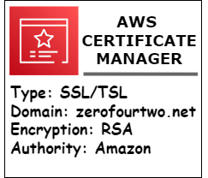
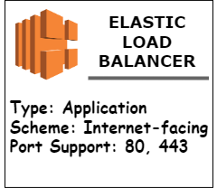
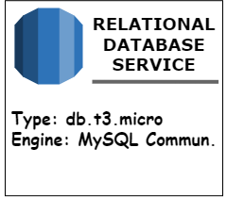
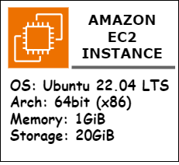
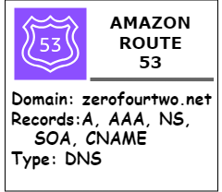

Technology Review
Node JS
Docker
PM2
NGINX
MySQL
Express JS
TensorFlow
AWS Services
Angular JS
Chart.js
Apache Spark
Utilization
Data visualization
Version
4.4.0
Why me?
- Lightweight library that can be embedded into a web page
- Compatible with all modern browsers
Utilization
Store Regularized User Data
Version
8.0.33
Why me?
- Robust relational database.
- Widespread industry wide adoption.
- Provides by far more efficient data manipulation possibilities than Document No SQL Database.
Utilization
Virtualization of Applications
Version
24.0.5
Why not me?
- Average size of a single unit exceeding 400mb presents a bandwidth utilization overhead for continuous build and deploy.
- Unfeasible due to potential cost overrun.
- Not utilized.
Utilization
Executive Dashboard
Version
15.2.10
Why me?
- Offers two-way data binding and component-based architecture
- Modular services that can be injected into other components.
- Dynamic Single page applications
Utilization
Back-end web application development framework.
Version
4.18.2
Why me?
- Minimalistic & Unopinionated framework.
- Widespread industry wide adoption.
- The de facto standard for Node JS.
Utilization
Building and training an A.I Model
Version
2.15.0.post1
Why me?
- Flexible, and supports different configuration of Neural Network Models
- Open source with large community and easily accessible documentation and guides.
Utilization
Reverse Proxy
Version
1.18.0
Why me?
- Very Lightweight and suitable for purpose.
- Enables running multiple independent services on a single virtual machine.
- Enables caching, and greatly reduces latency.
- Minimal setup.
Utilization
Demonizing Application
Version
5.3.0
Why me?
- Compatible with NodeJS Application.
- Lightweight & keeps application running through multiple reboots and system upgrade.
- Provides logging for analytics.
Utilization
Development and Deployment Environment
Version
20.10.0
Why me?
- Small memory footprint for a viable on-cloud deployment.
- Provides a single platform for server and client deployment.
- Robust, with industry wide adoption.
Utilization
Building and training an A.I Model
Version
3.5.0
Why me?
- In-memory data processing
- Scalable as it can handle increasing amounts of data
- Opens source with large supporting community

Slide 6
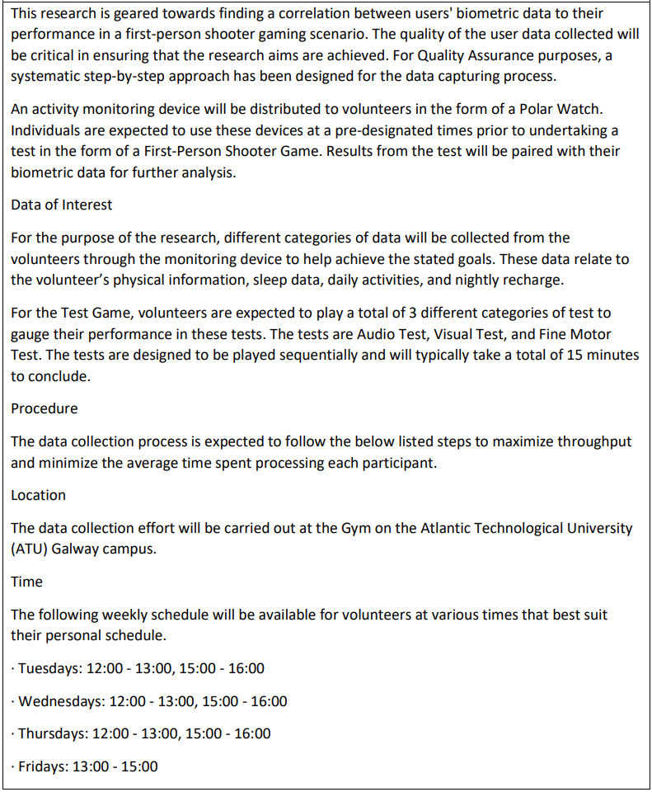
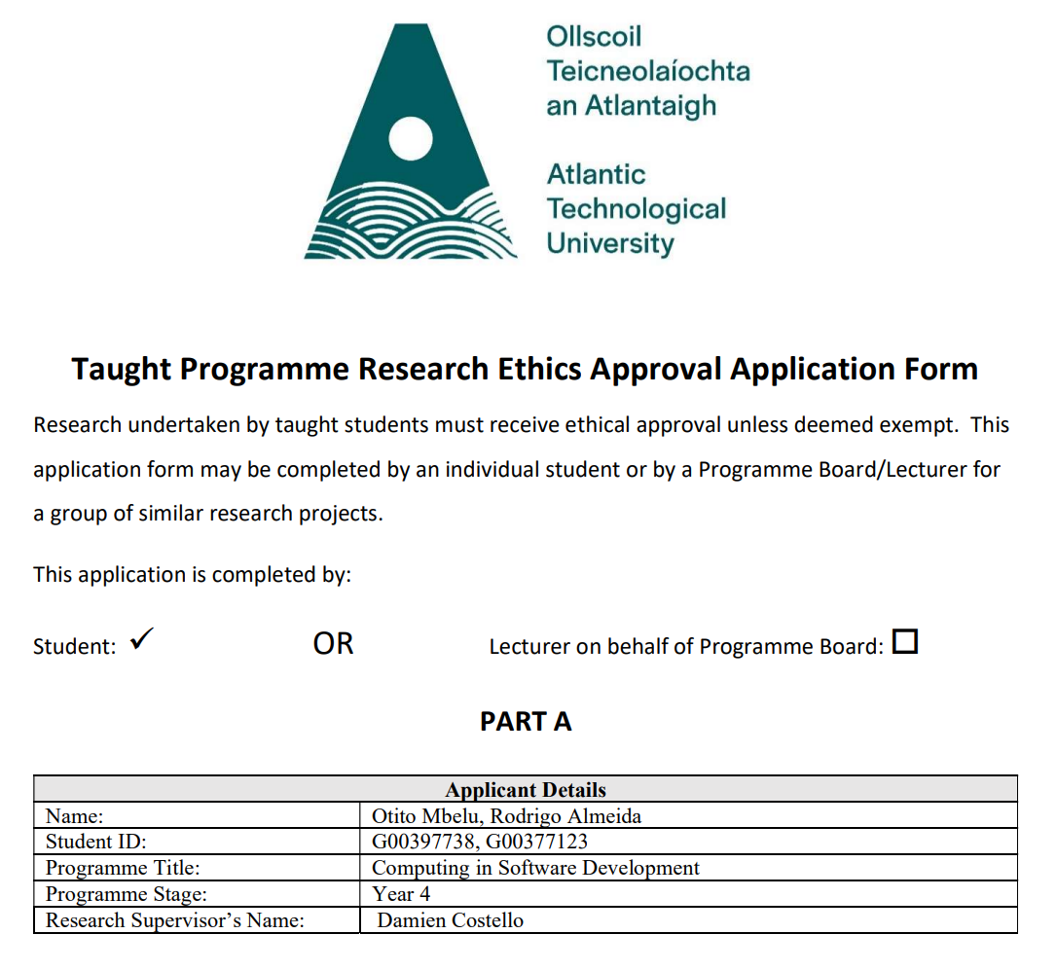
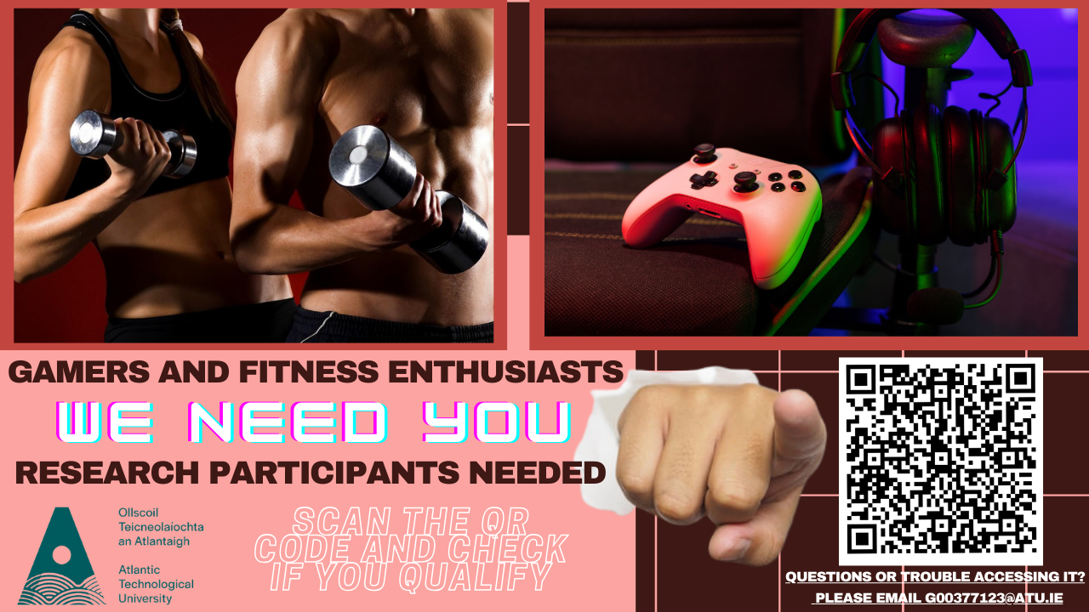
Data Collection
Methodology:
Activity monitoring devices distributed to volunteers
Physical information, sleep data, daily activities, and nightly recharge collected
Volunteers should play 3 categories of test – Audio, Visual and Fine Motor
Volunteers Recruitment:
5 to 10 volunteers required
Form will be sent to the department mailing list
MS form to be filled out
Volunteers are chosen accordingly to their details
Ethics Application:
The project requires an ethics approval
Rigorous evaluation before approval

Slide 7
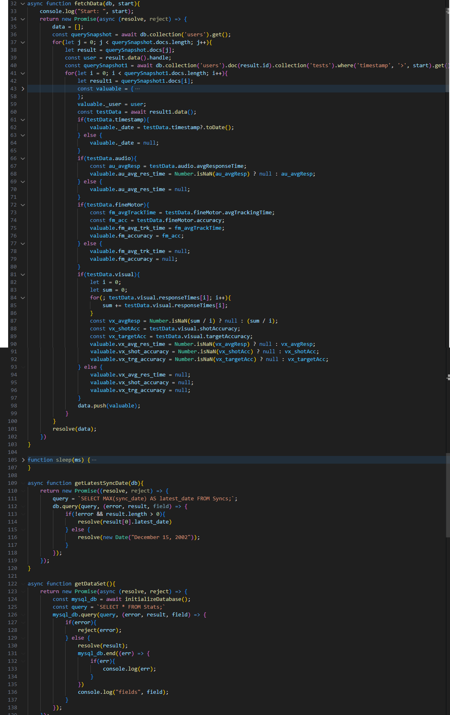
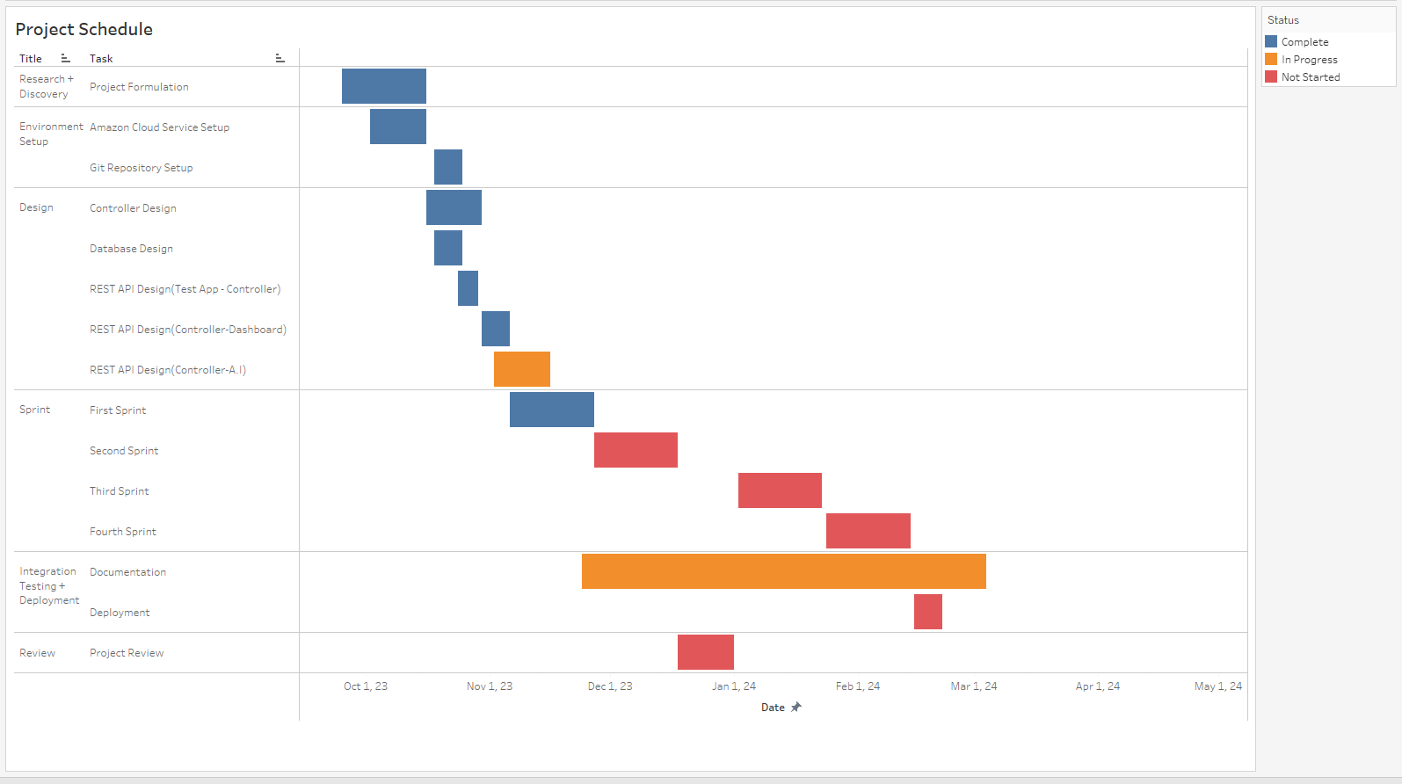
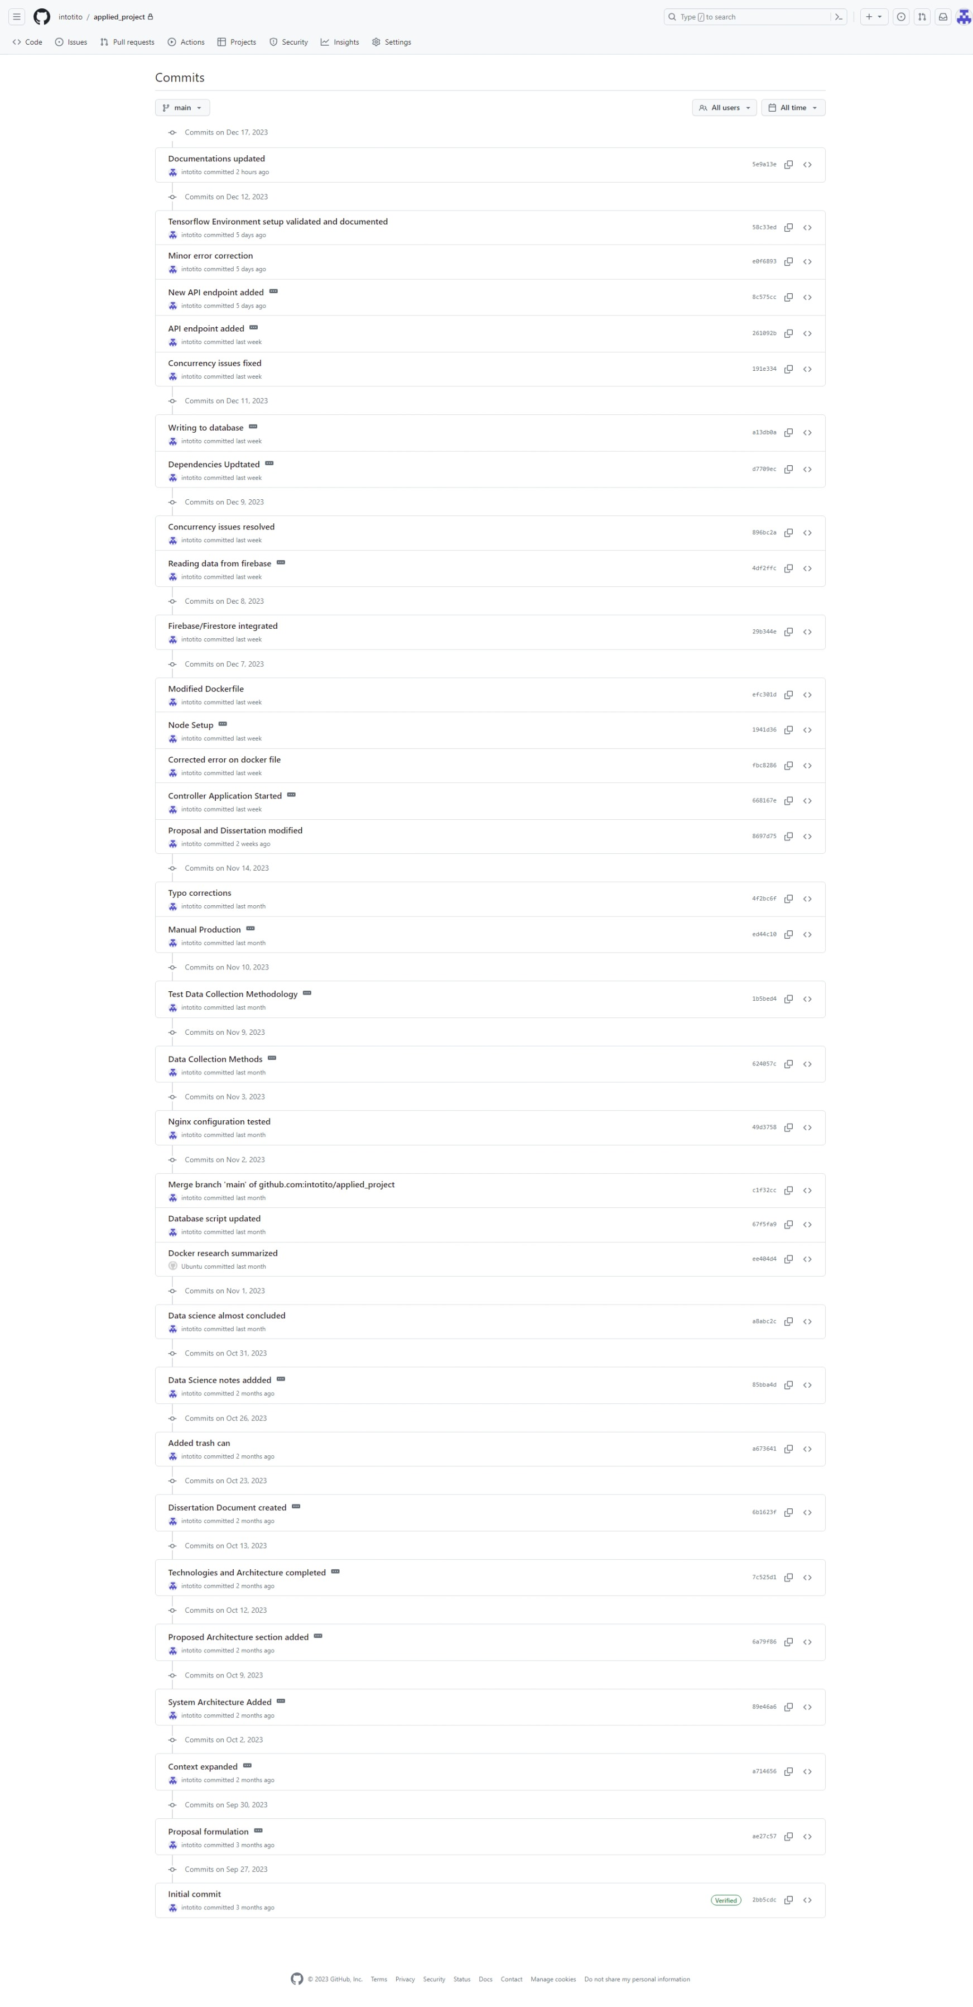
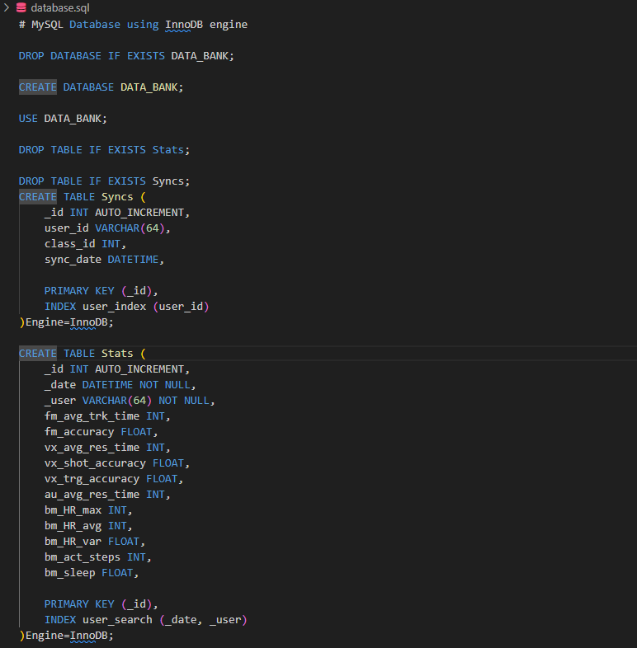
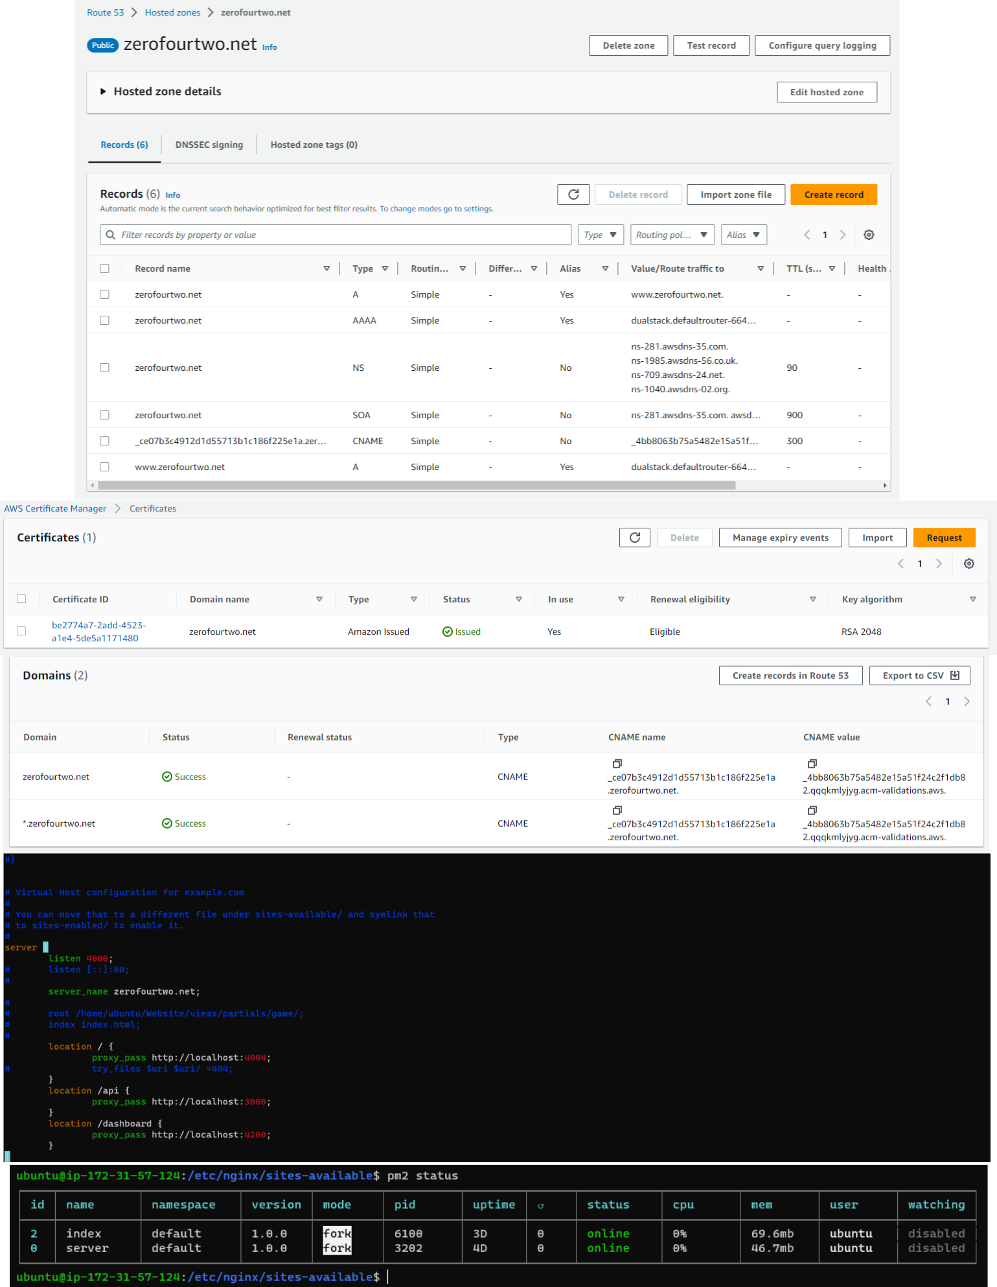
GIT COMMITS
CONFIGURATIONS
CODE SNIPPETS
GANTT CHART

Slide 8
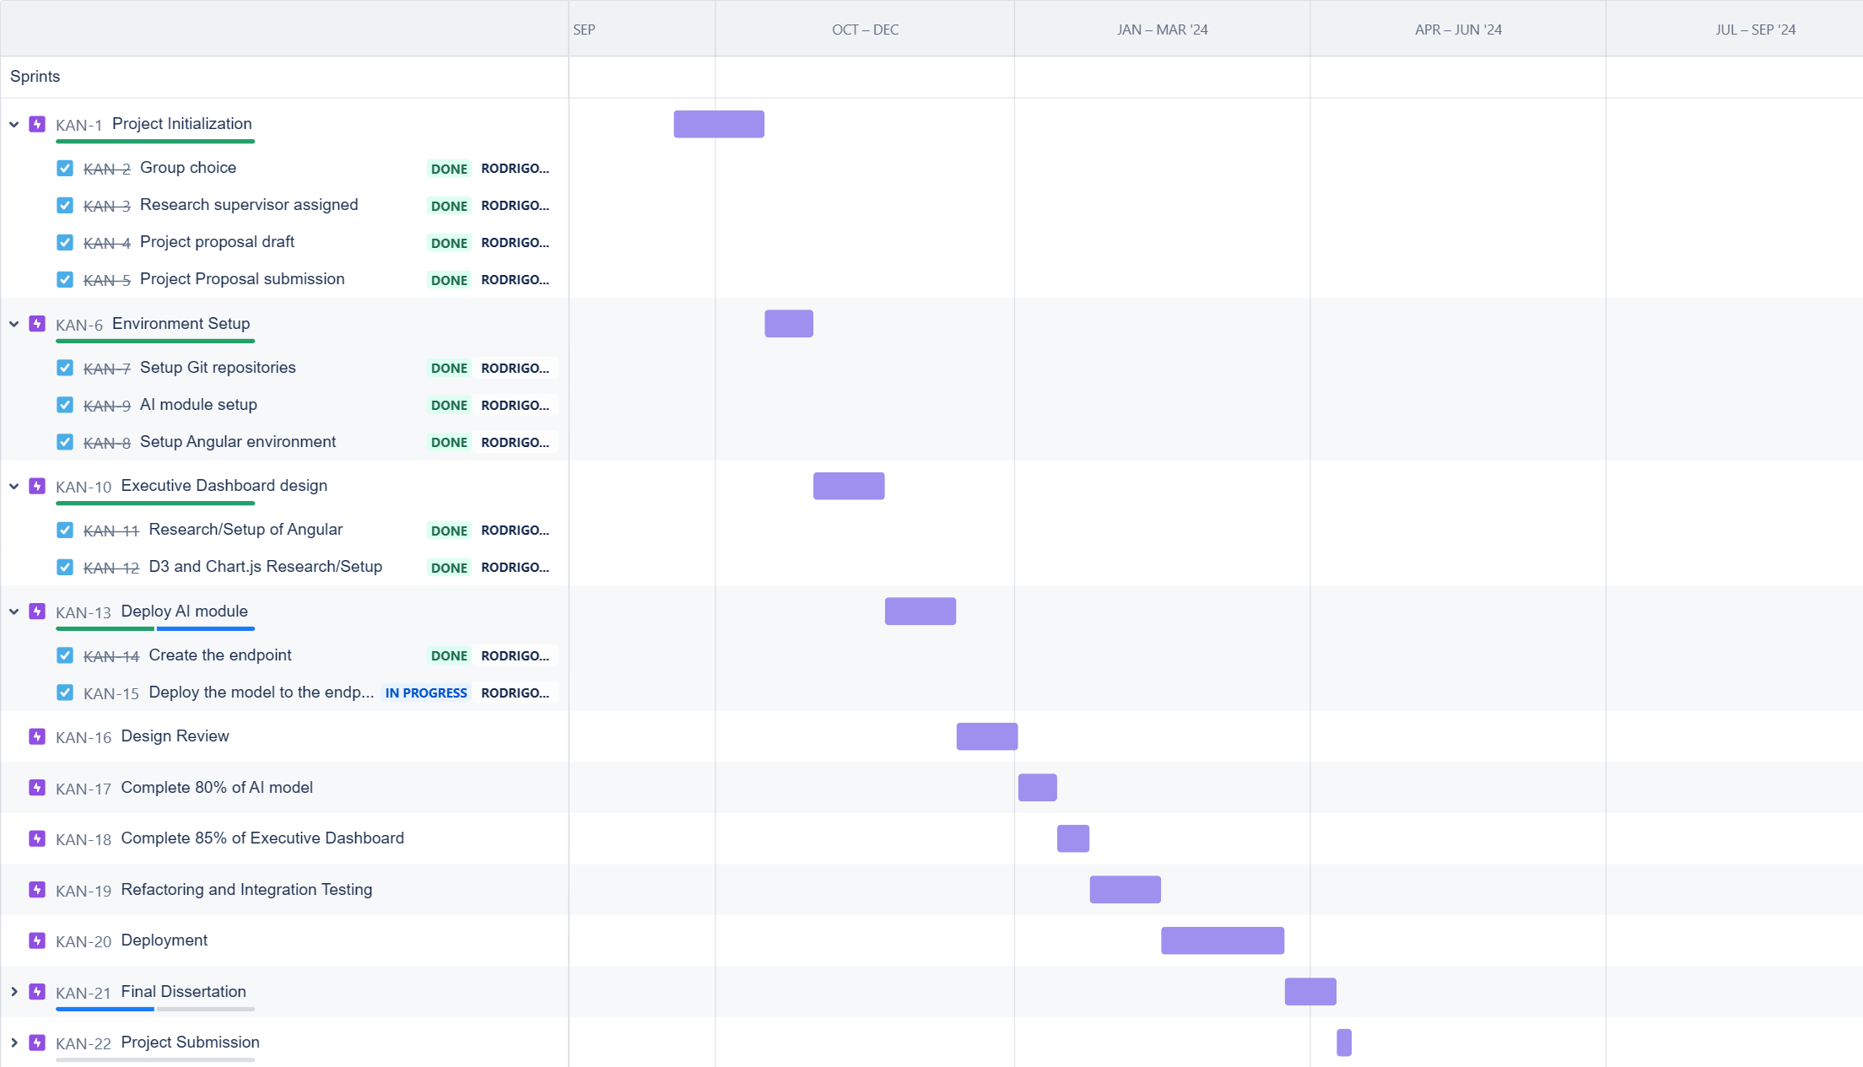
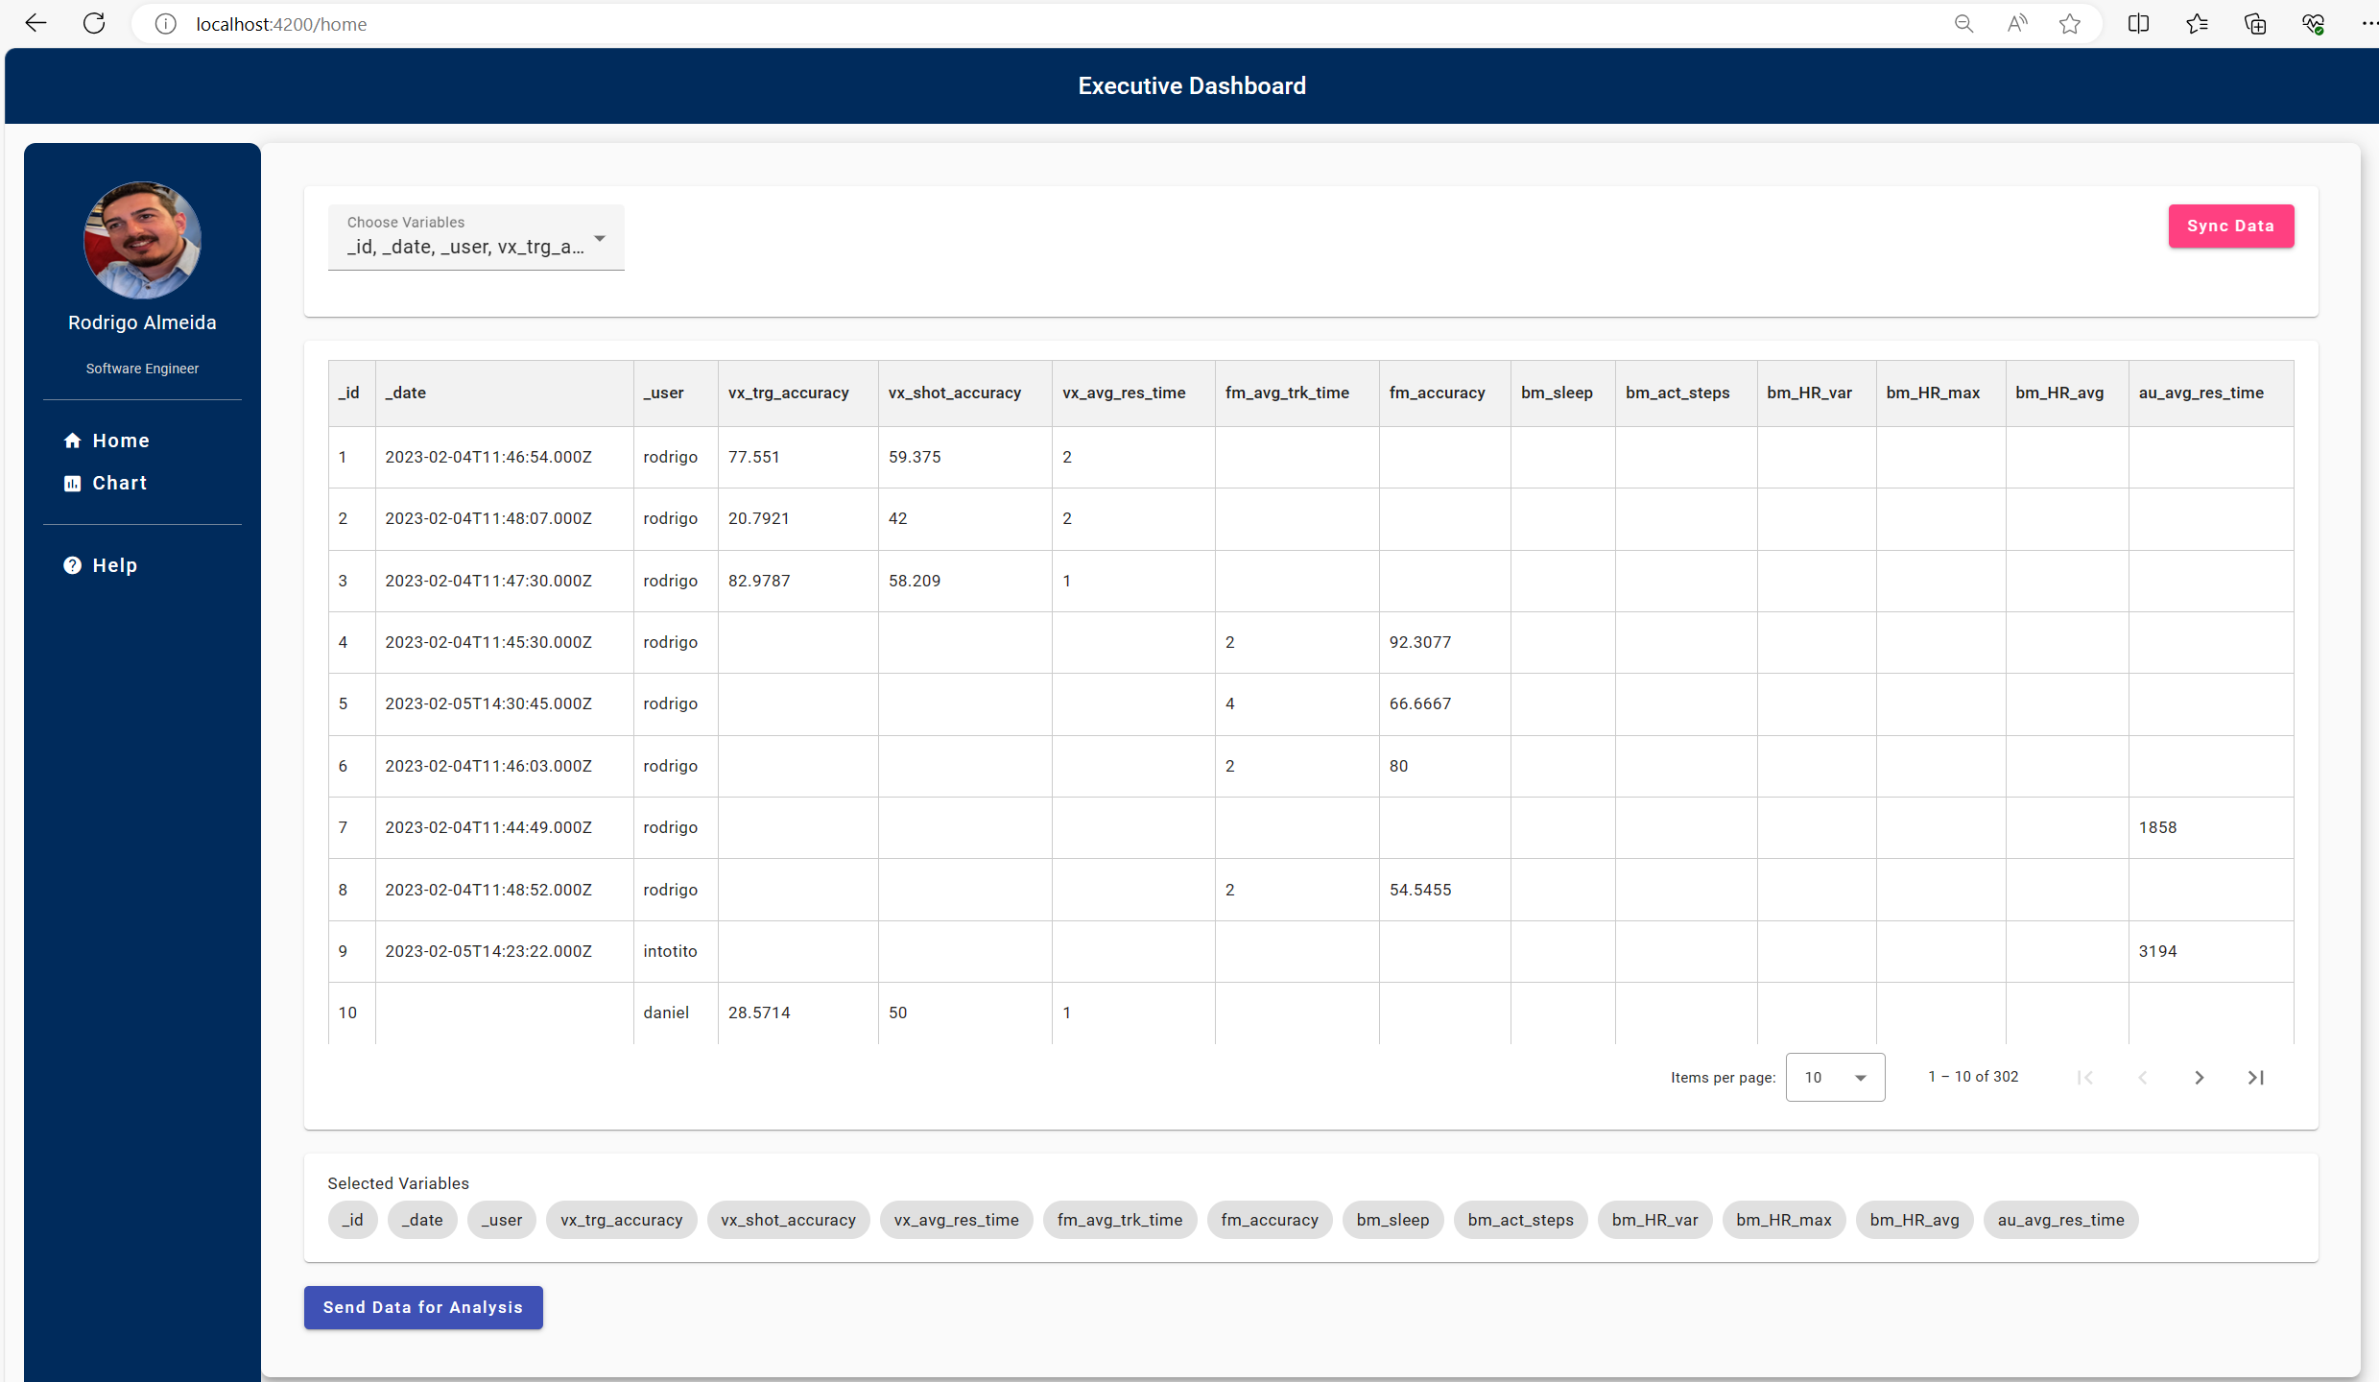
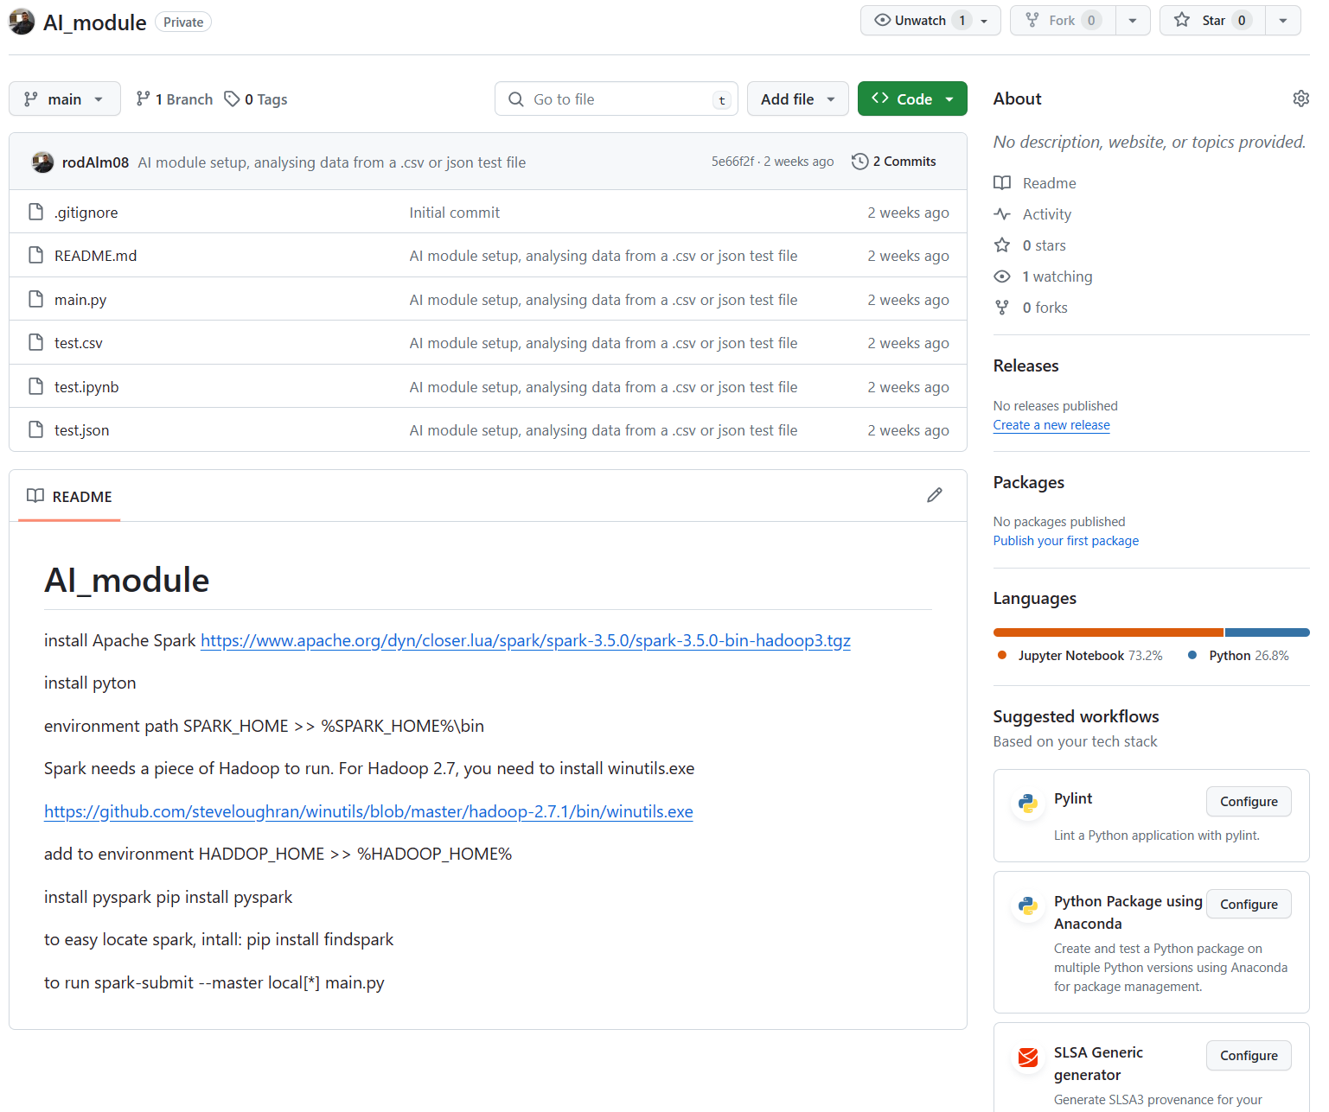
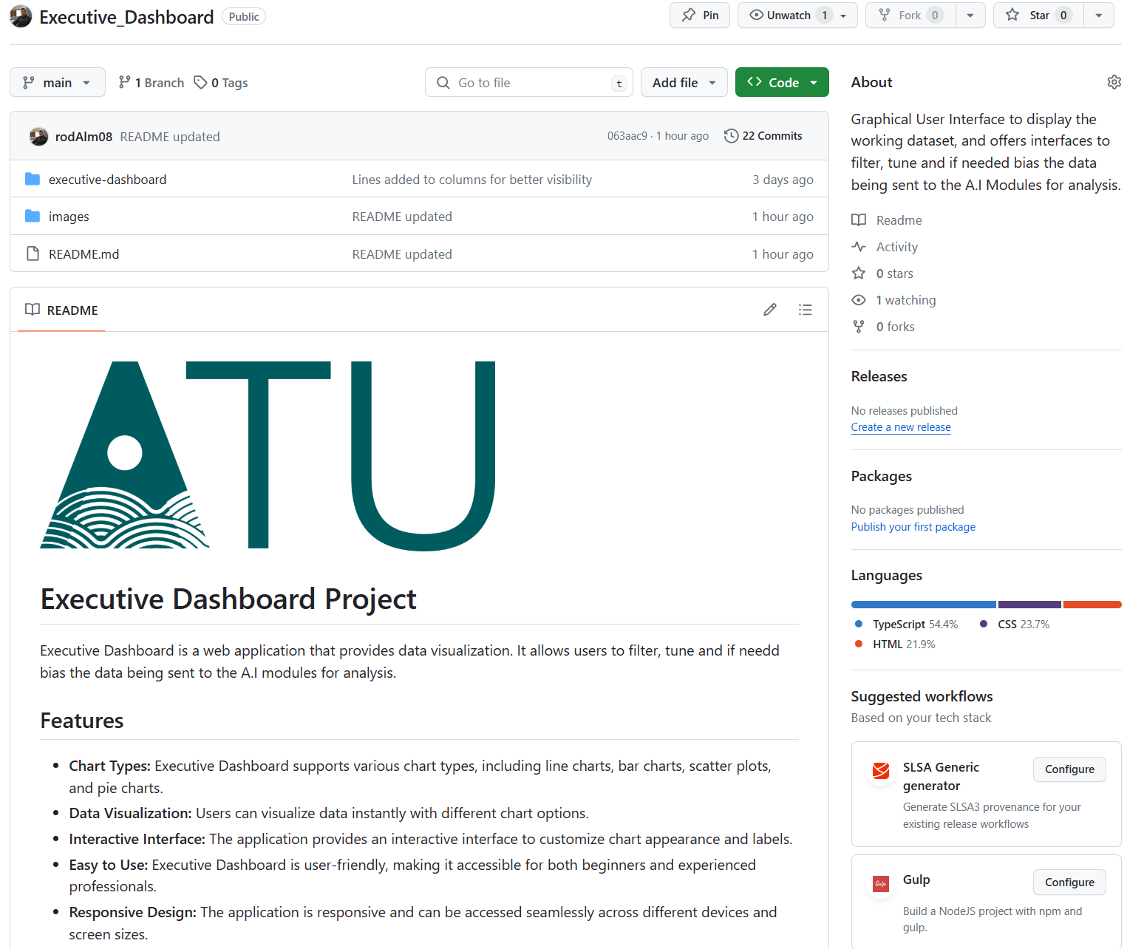
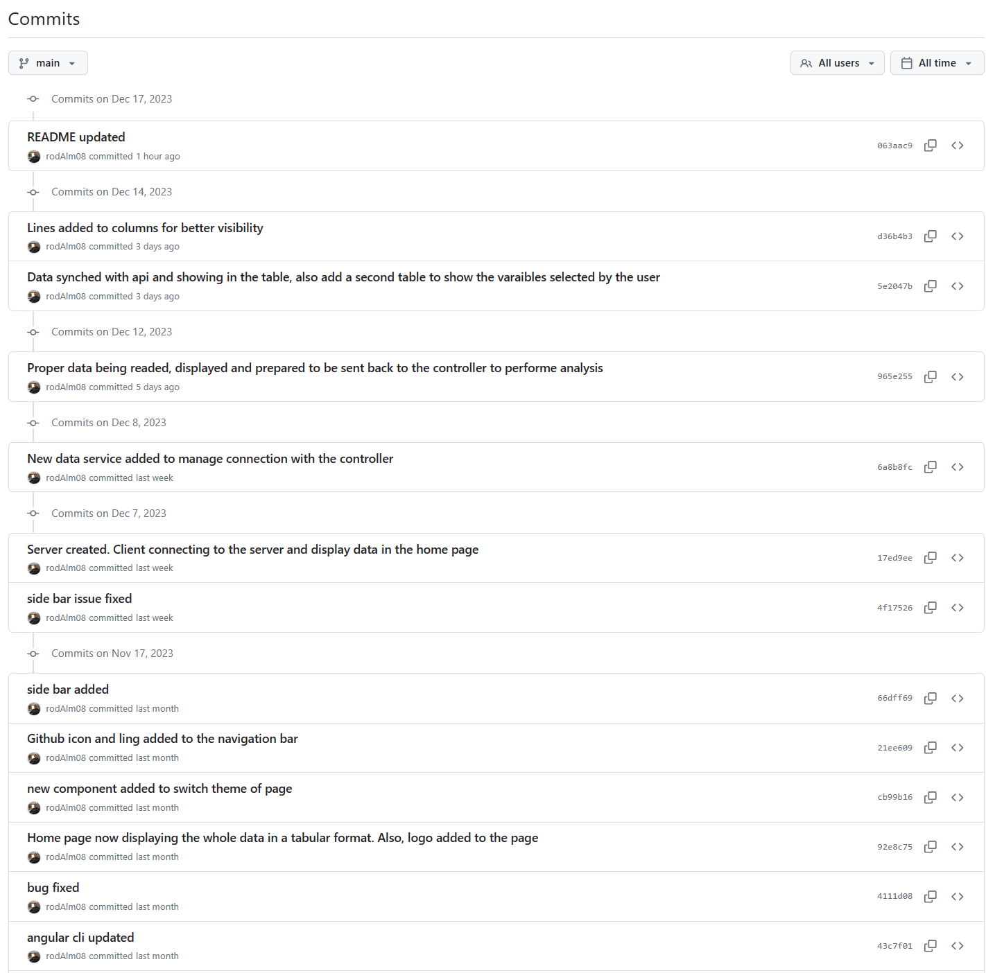
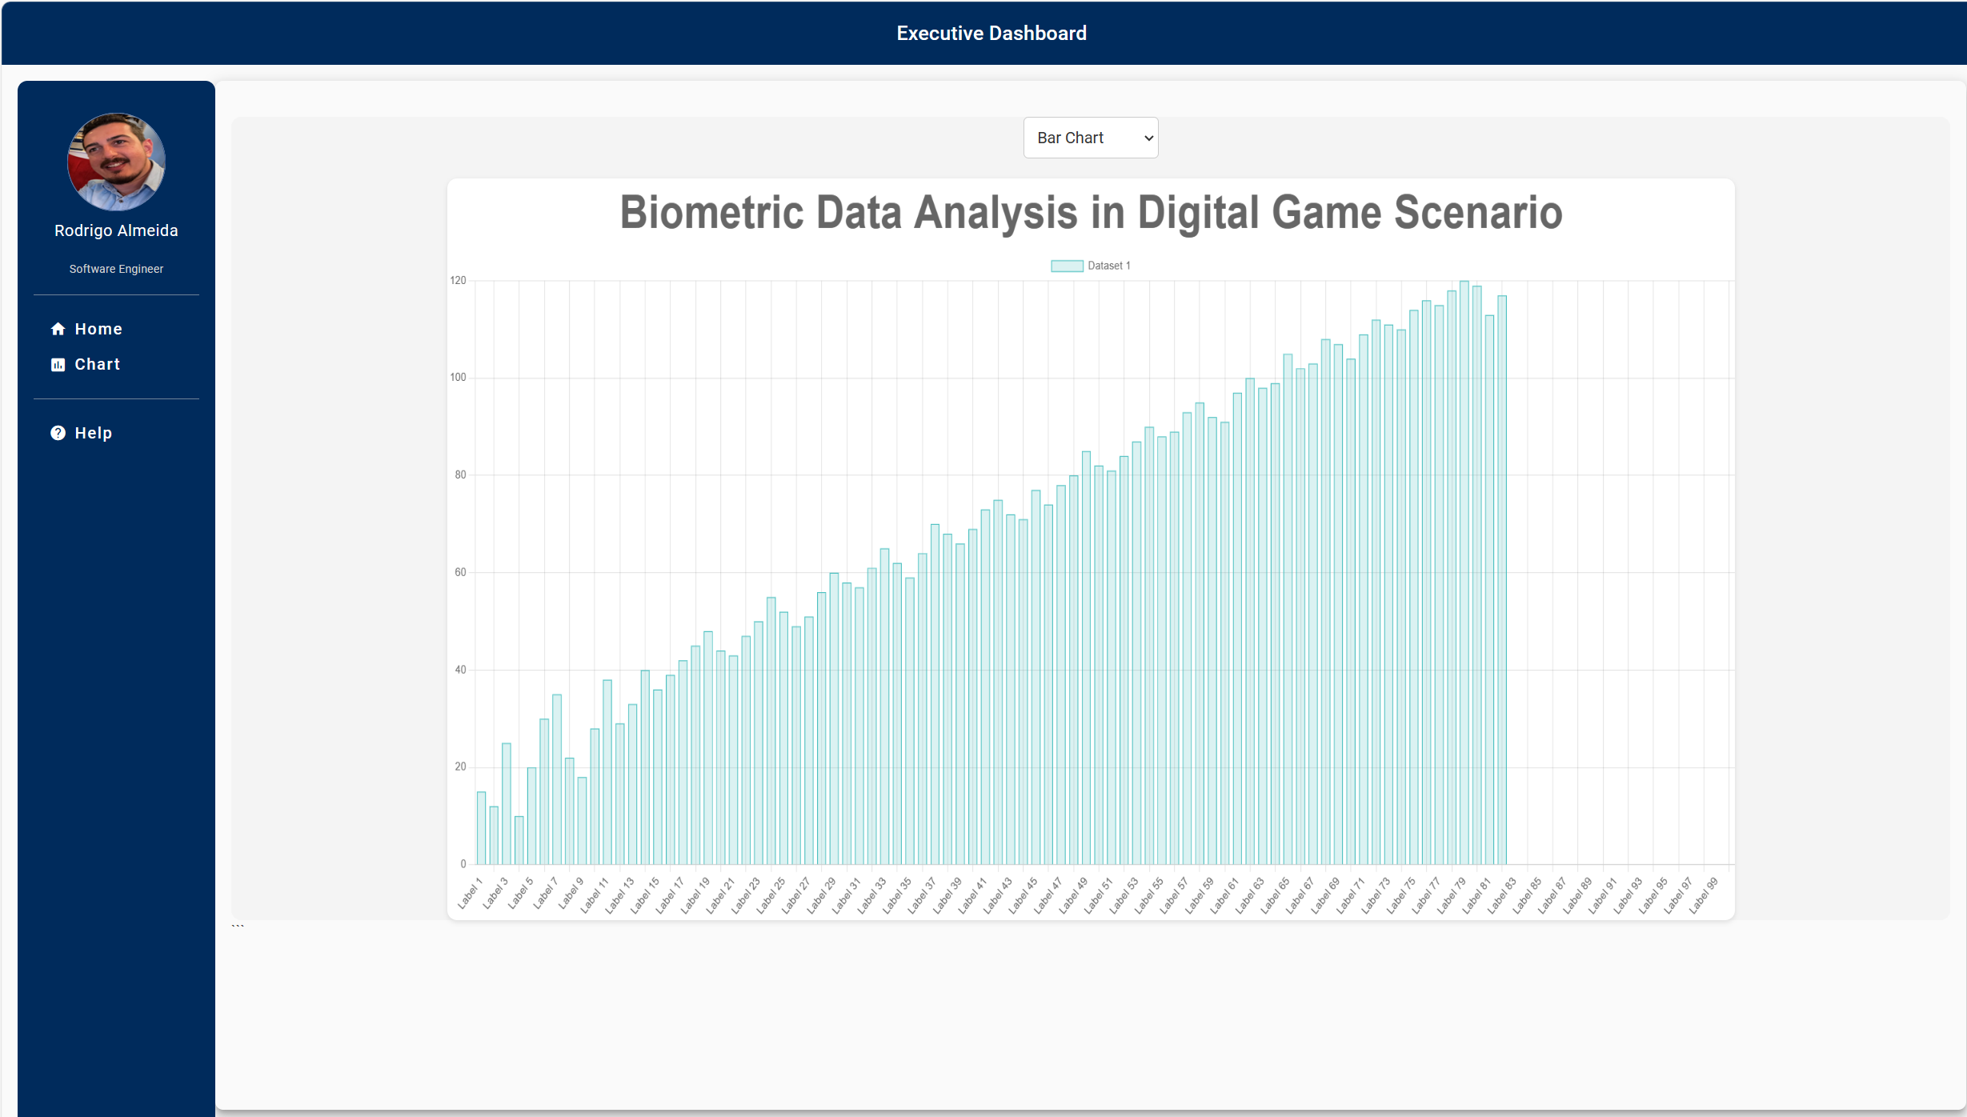
Git Commits
Gantt Chart
Executive Dashboard

Slide 9


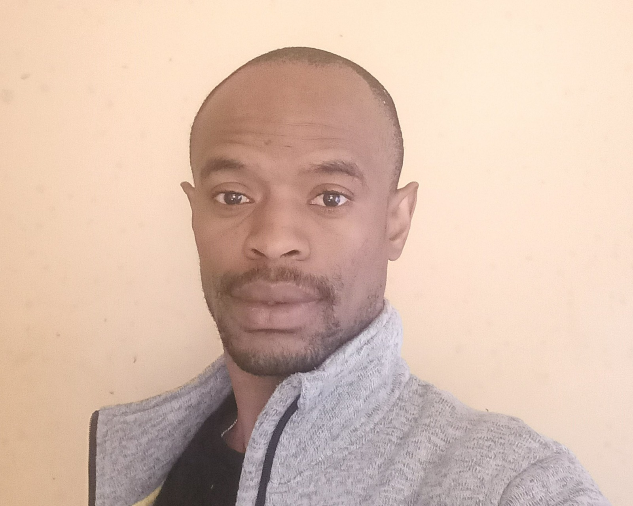
Our Team
Rodrigo Almeida
Otito Mbelu
G00377123
G00397738

Slide 10
Thank You!

